Slide 1
Amazon Fresh Analytics
Problem Solving Using Data Modeling & SQL

Slide 2
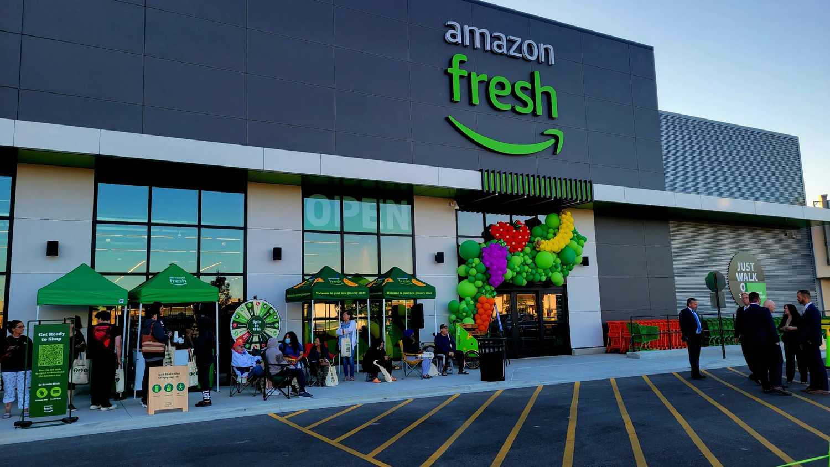
agenda
Amazon Fresh manages large volumes of data such as customers, products, suppliers, orders, and reviews.
The challenge is to design a relational database that supports efficient storage, analysis, and decision-making to improve operations, customer satisfaction, and revenue.

Slide 3
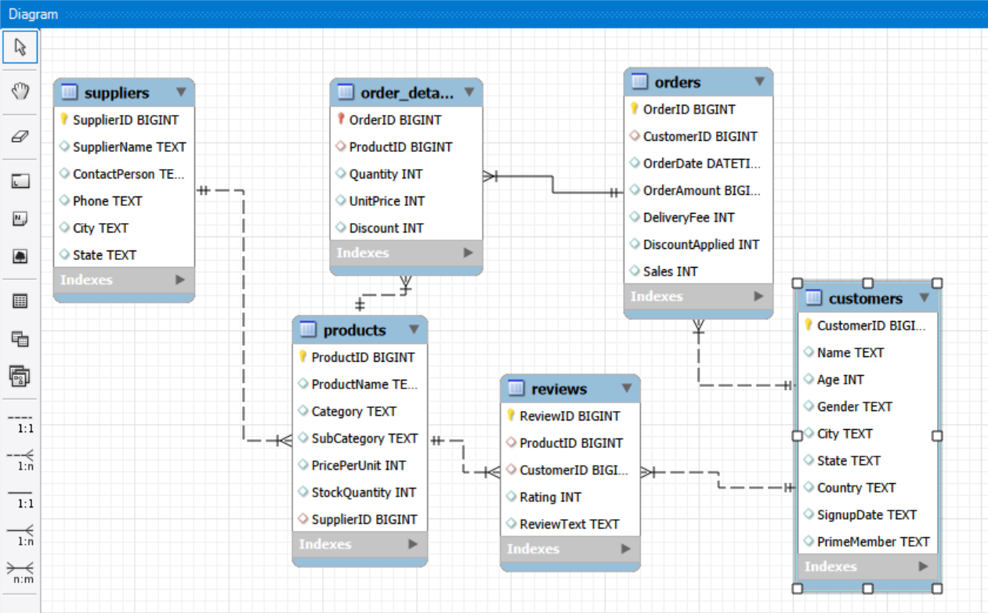
Task 1: Create an ER diagram for the Amazon Fresh database to understand the relationships between tables (e.g., Customers, Products, Orders).
One-to-Many Relationships (1:N)
Customer → Orders (one customer can place many orders)
Supplier → Products (one supplier can supply many products)
Product → Reviews (one product can have many reviews)
Many-to-Many Relationships (Resolved via Order_Details)
Orders ↔ Products (an order can have many products; a product can be in many orders)

Slide 4
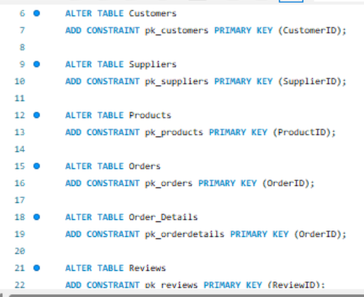
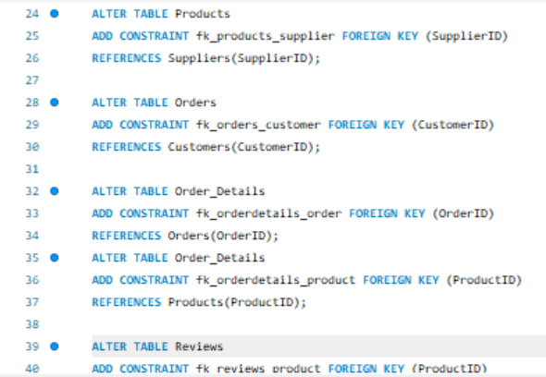
Task 2: Identify the primary keys and foreign keys for each table and describe their relationships.
Syntax for Primary Key
Syntax for Foreign Key
This syntax defines primary and foreign key constraints to uniquely identify records and enforce proper relationships between all tables in the database.

Slide 5
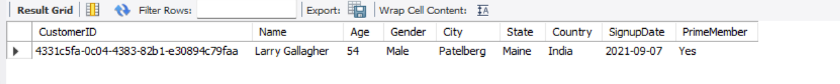
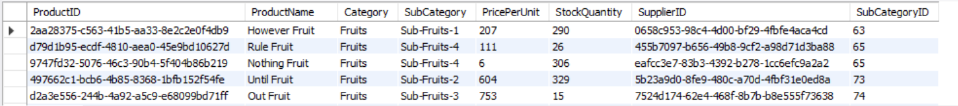
Task 3: Write a query to
Output
Syntax
# Retrieve all customers from a specific city
SELECT * FROM Customers
WHERE city = 'Patelberg';
# Fetch all products under the "Fruits" category
SELECT * FROM Products
WHERE category = 'Fruits';
Note: These queries use the WHERE clause to filter records and retrieve specific data based on city and product category.
Amazon Fresh can use the city-based query to target customers in a specific location and the category-based query to manage fruit stock efficiently.
These queries help in targeted analysis, improve performance by reducing data load, and support better business decisions.”

Slide 6
Task 4: Write a query to
DDL to Recreate Customers Table
Syntax
CREATE TABLE CustomersID (
CustomerID INT PRIMARY KEY,
Name VARCHAR(255) UNIQUE,
Age INT NOT NULL CHECK (Age > 18));
Here:
CustomerID is defined as the Primary Key, so each customer is uniquely identified.
Age is marked as NOT NULL and must be greater than 18, ensuring valid customer age.
Name has a UNIQUE constraint, preventing duplicate customer names.
Other columns store additional customer information.
Note: This DDL statement recreates the Customers table with primary key, unique, and validation constraints to maintain data integrity.

Slide 7
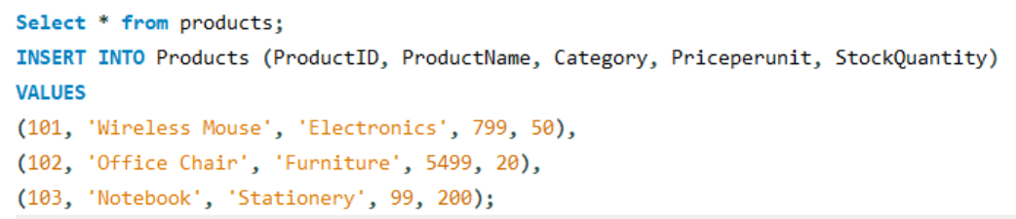
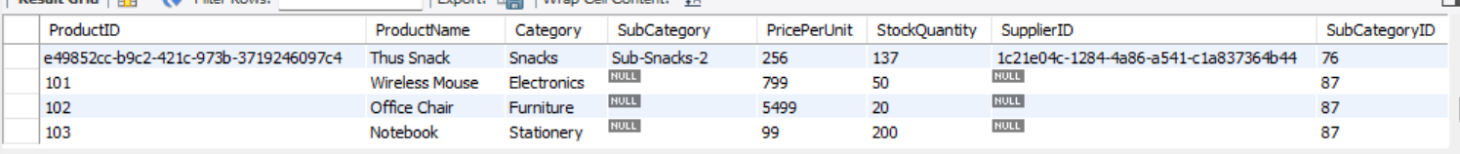
Task 5: Insert 3 new rows into the Products table using INSERT statements
Syntax
Output
Note: This task shows how to insert multiple product records into a table using a single INSERT statement and verify the output.

Slide 8
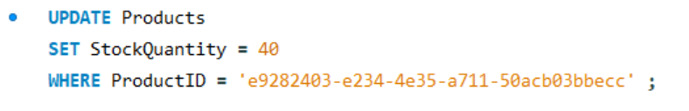
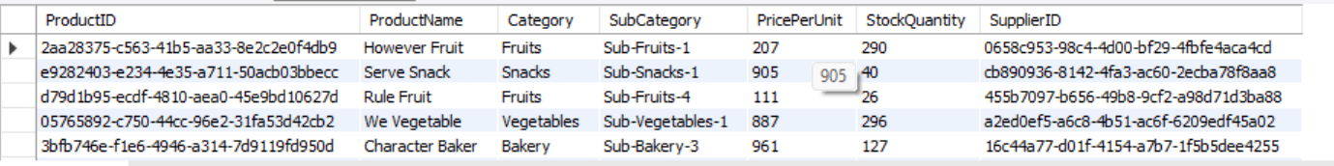
Task 6: Update the stock quantity of a product where ProductID matches a specific ID
Syntax
Output
Note: The WHERE clause is essential in UPDATE statements to avoid unintended changes to multiple records and to maintain data accuracy..

Slide 9
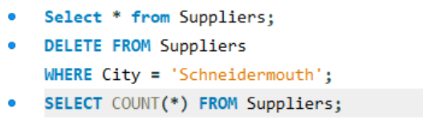
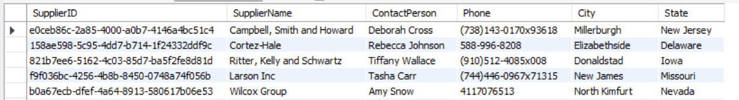
Task 7: Delete a supplier from the Suppliers table where their city matches a specific value.
Syntax
Output
Note: The updated table confirms that suppliers from Schneidermouth have been successfully removed.
The COUNT(*) result helps verify the change in total records.

Slide 10
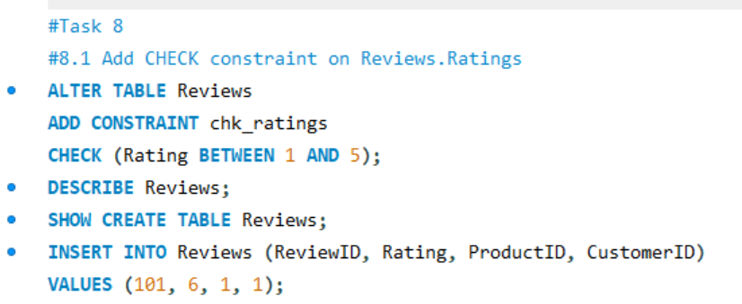
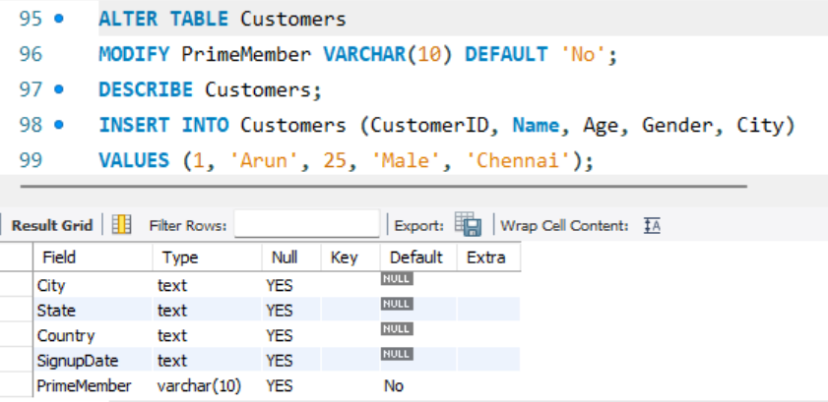
Task 8: Use SQL constraints .
#8.1 Add CHECK constraint on Reviews. Ratings
#8.2 Add DEFAULT constraint for Customers. PrimeMember
Error Message Occurs when we insert Rating above 5
Note: We can verify the CHECK constraint by using SHOW CREATE TABLE or by testing invalid data insertion..
Note: The DEFAULT constraint ensures that when no value is provided for PrimeMember, it is automatically set to 'No'.

Slide 11
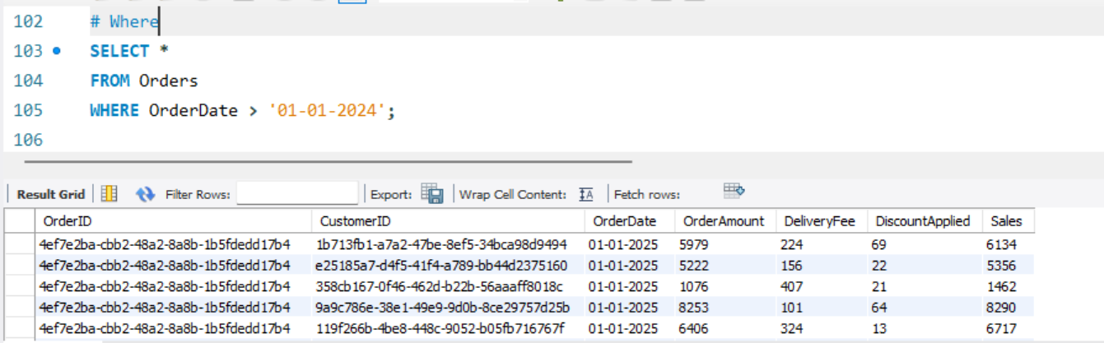
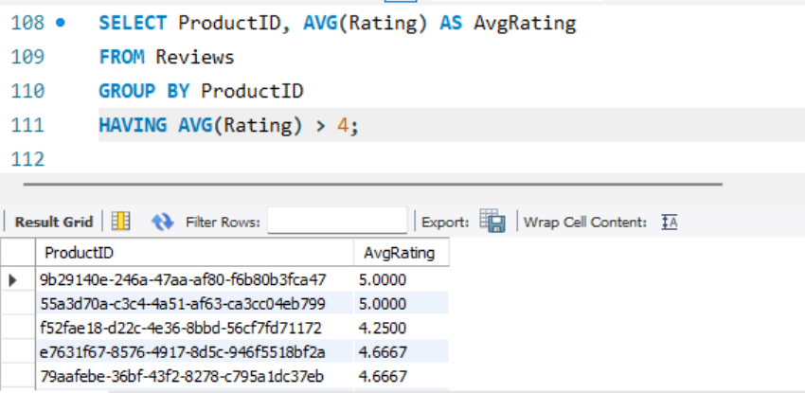
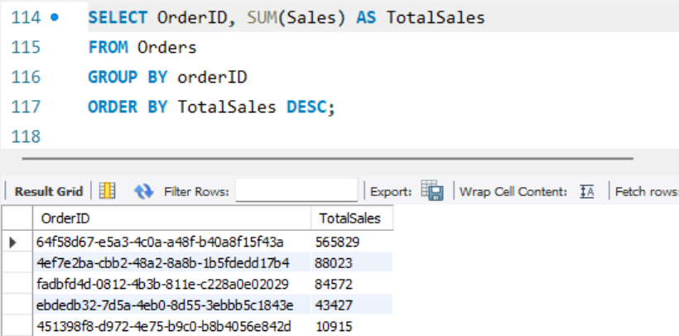
Task 9: Write queries using.
#9.1 WHERE clause to find orders placed after 2024-01-01.
#9.2 HAVING clause to list products with average ratings greater than 4.
Syntax
Output
Note: Shows only orders with dates beyond the specified threshold.
Note: Displays products that meet the average rating condition.
#9.3 GROUP BY and ORDER BY clauses to rank products by total sales.
Syntax
Output
Note: Orders ranked from highest to lowest total sales.

Slide 12
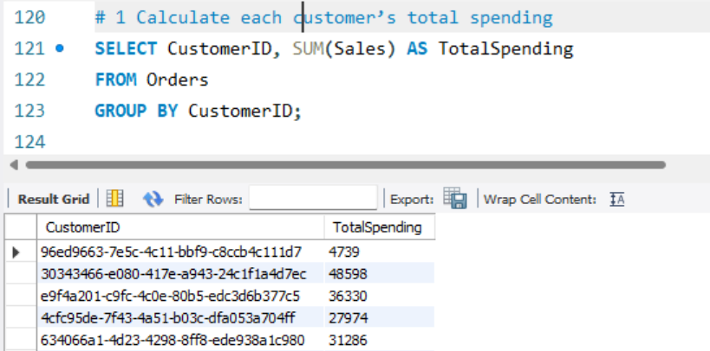
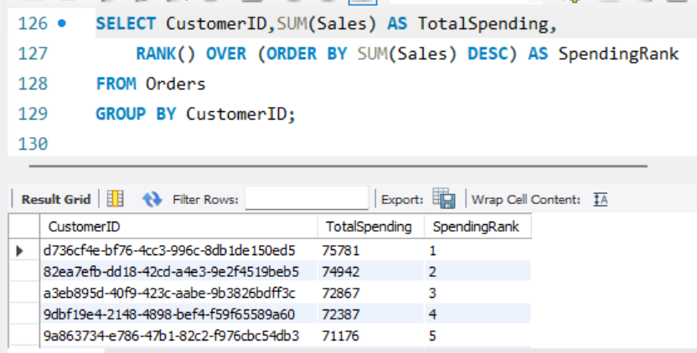
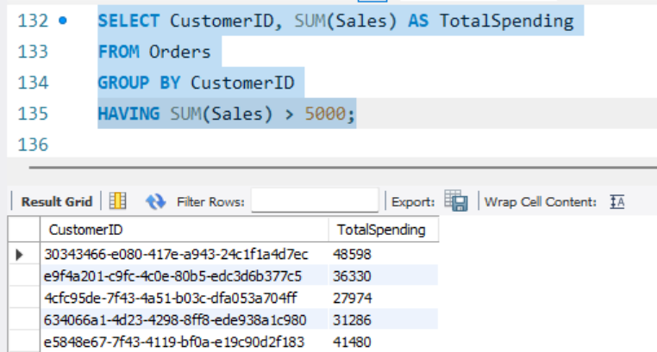
Task 10: Identifying High-Value Customers
#10.1 Calculate each customer's total spending..
#10.2 Rank customers based on total spending
Syntax
Output
Note: Shows total spending for each customer.
Note: Displays each customer’s rank based on spending.
#10.3 Identify customers who spent more than ₹5,000
Syntax
Output
Note: Lists only those customers who meet the spending threshold.

Slide 13
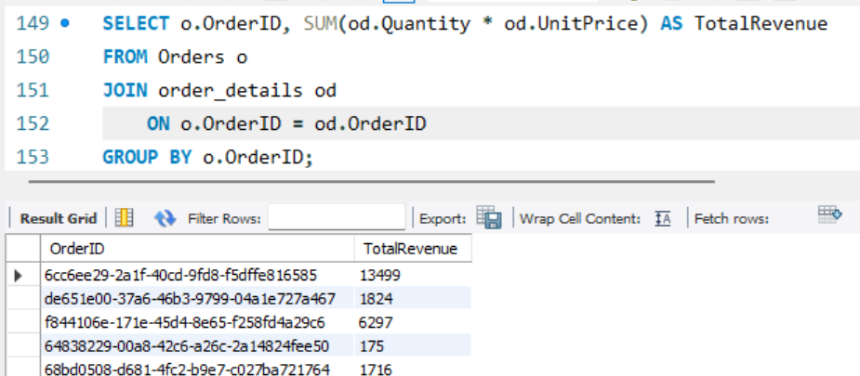
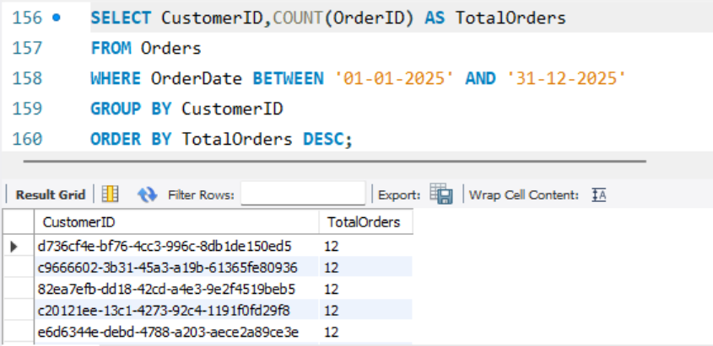
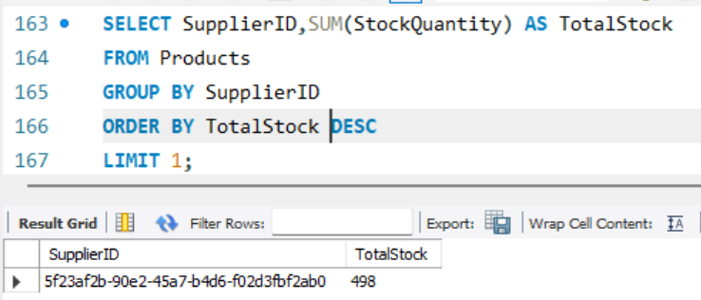
Task 11: Use SQL to
#11.1 Join the Orders and OrderDetails tables to calculate total revenue per order.
#11.2 Identify customers who placed the most orders in a specific time period.
Syntax
Output
Note: Shows revenue per order by aggregating item-level details.
Note: Lists customers with the highest order count in the specified range.
#11.3 Find the supplier with the most products in stock
Syntax
Output
Note: Displays the top supplier based on total stock.

Slide 14
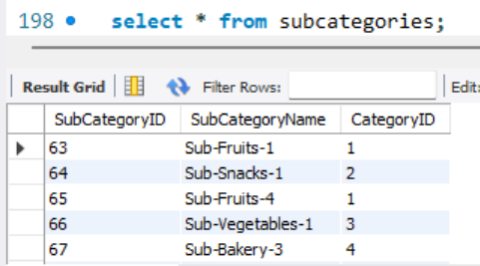
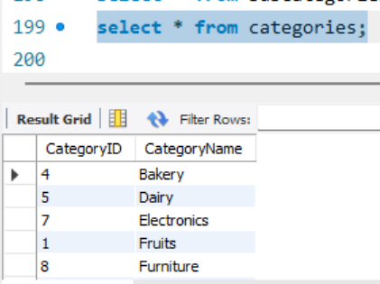
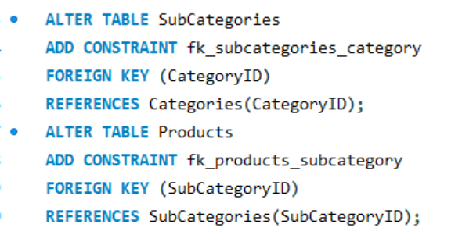
Task 12: Normalize the Products table to 3NF
#12.1 Separate product categories and subcategories into a new table.
Categories (CategoryID)
SubCategories (CategoryID, SubCategoryID)
Products (SubCategoryID)
#12.2 Create foreign keys to maintain relationships.
Notes:
Foreign keys are used to link related tables.
CategoryID in SubCategories references the Categories table.
SubCategoryID in Products references the SubCategories table.
These relationships ensure referential integrity.
Invalid category or subcategory values cannot be inserted.

Slide 15
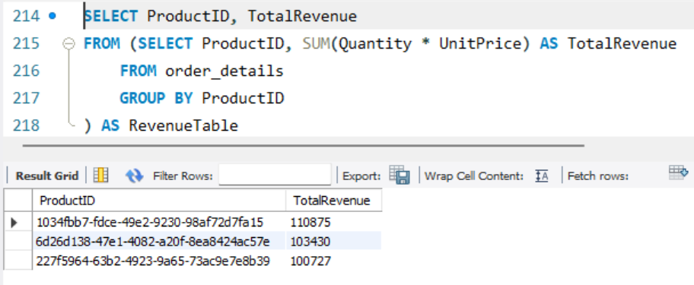
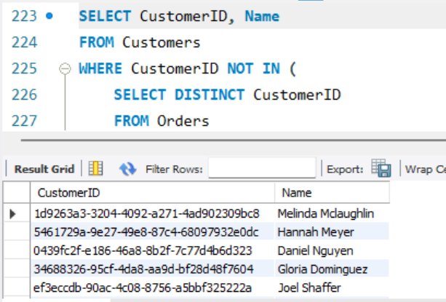
Task 13: Write a subquery to
#13.1 Identify the top 3 products based on sales revenue.
#13.2 Find customers who haven’t placed any orders yet.
Notes: Displays the top 3 products with the highest revenue.
Notes:
Lists customers who are registered but inactive in terms of purchases.
This is useful for targeting inactive users in marketing or retention campaigns.

Slide 16
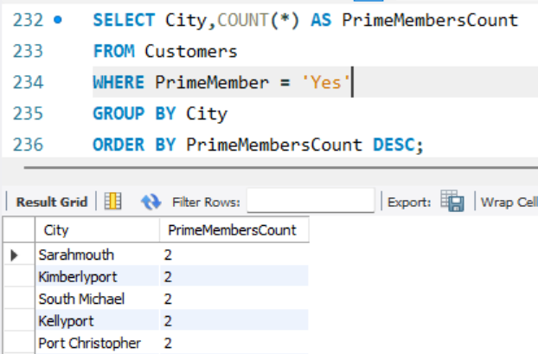
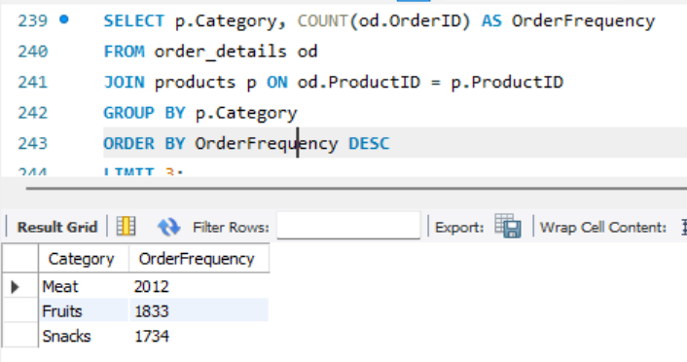
Task 14: Provide actionable insights
#14.1 Cities with the highest concentration of Prime members
#14.2 Top 3 most frequently ordered categories
Note:
Shows top cities with the highest number of Prime members.
These cities may be ideal for launching exclusive offers or early access campaigns.
Note:
Lists the top 3 categories by order volume.
These categories can be prioritized for inventory, promotions, or bundling strategies.

Slide 17

Thank you

